Slide 1
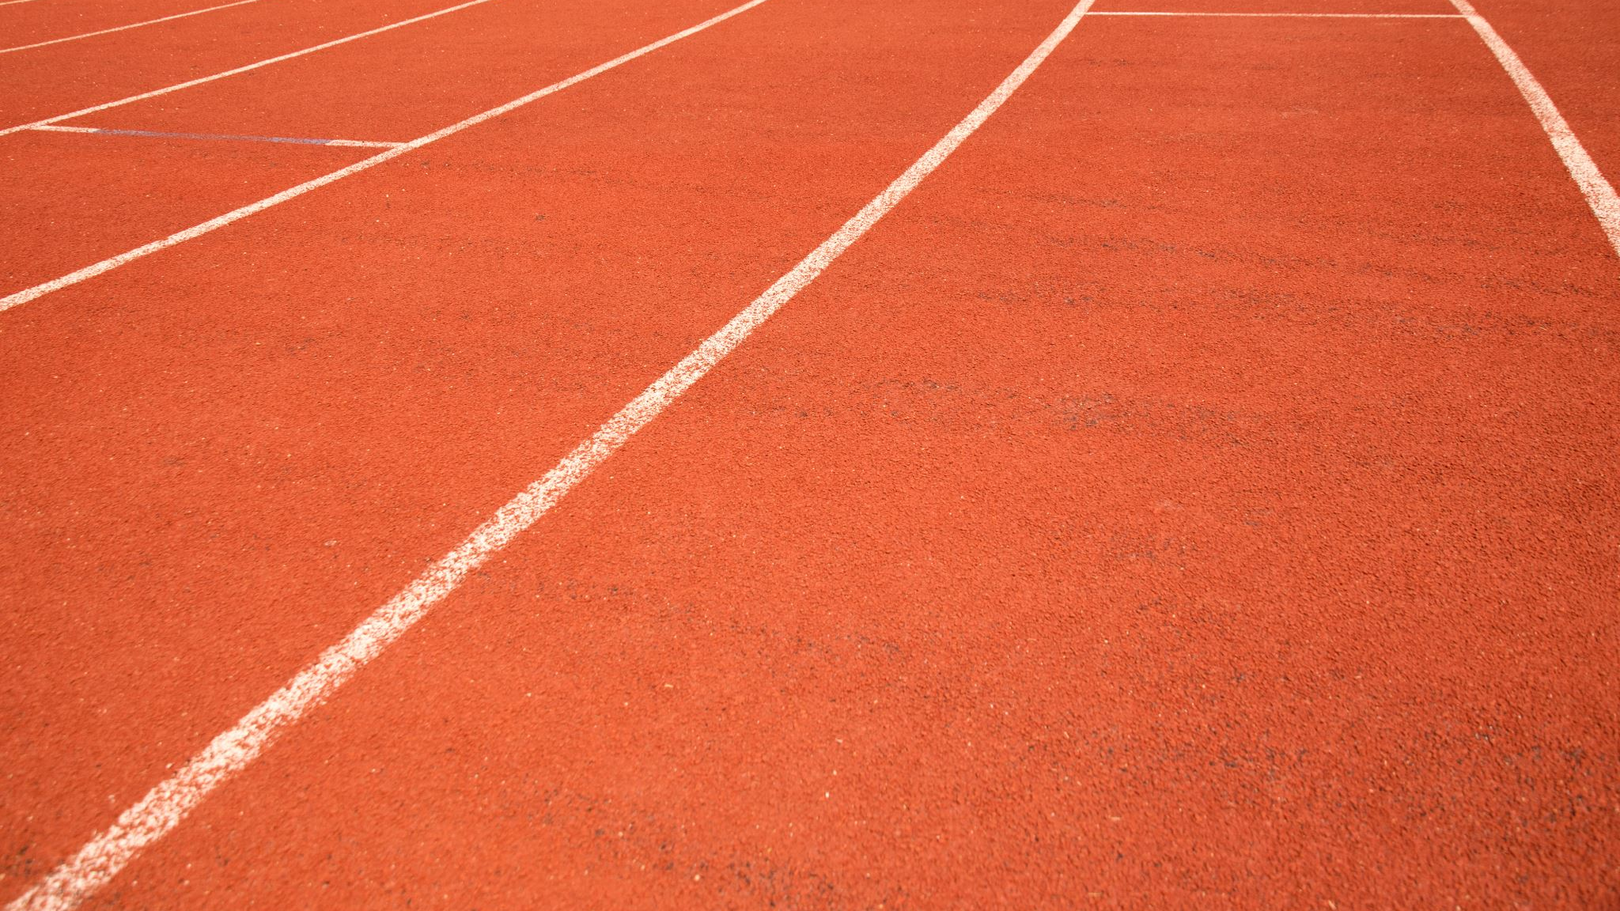
ROLE OF A TRACK REFEREE
Focus on club and county level events

Slide 2
THE REFEREE (CR18)
(Track Referee – from 2018-20 UKA Rule Book):
Has charge of all track events
Ensures safe practise
Allocates duties to judges/umpires
Ensures the Rules and Regulations are observed
Shall rule on any protests or objections
Decides on matters not covered in the rules
Decides on any rulings of warnings or disqualifications (DQs)
Has the power to decide on placings only when the Judges are unable to reach a decision on a disputed placing (excluding Race Walking)
Has the power to decide on any facts related to the starts if they do not agree with the decision reached by the start team except when a false start is indicated by the Start Information System (SIS) – NB: at National or International meetings, a Start Referee may be appointed. They have overall control on the conduct of starts instead of the Track Referee
NB: YOU have full responsibility for all activity on the track in every area

Slide 3
NB Roles of Equipment Officer and Clerks of Course not in WA Rules
Management team
Competition Director / Meeting Manager (Rules 14/15)
Technical Manager (Rule 16) (this is usually a field official selected for this role)
CD plans the technical organisation of a competition, ensures the plan is accomplished and resolves technical problems
CD directs interaction between participants and is in contact with all key officials.
MM responsible for the correct conduct of Competition.
The MM ensures that only authorised persons are allowed in the centre of the Field of Play.
Ensures that track, runways, sectors and all equipment and implements conform to the Rules
Responsible for placement and removal of venue equipment and implements
Ensures the technical presentation of competition areas is in accordance with plan
Checking and marking of personal implements permitted for the competition according to Rule 32.2
Certification under Rule 10.1

Slide 4
UKA Supplementary document being updated
The Technical team
Equipment Officer
Clerks of Course
Ensures all venue equipment is prepared and available
Checks/marks all venue and personal implements
Ensures equipment is removed, cleaned and stored after use
Ensures any implement involved in a record is re-checked.
Ensure that all venue markings are in accordance with the Rules
Ensure that all equipment is in a fit state (both track and field)
Responsible for the placement and removal of equipment and implements
Ensures track/hurdles etc correctly set

Slide 5
Track Ref Accountability
To athletes – provide a fair competition, according to the Rules
To officials – allocate a balance of duties, within their capabilities, some stretch
To management – deliver the event according to plan
To spectators – Good competition with no undue delays
TO ALL – A SAFE, ENJOYABLE, WORTHWHILE EVENT

Slide 6
Other roles (Start team, Timekeepers, PF, Call Room, seeding, jury etc) omitted for clarity
Comp Director
Mtng Manager
The model – National
and Regional Level
Field Ref
Tech Mgr
Track Ref
Field Judges
Equip Officer
Track Judges
Clerks of Course

Slide 7
The reality – Local and County Level
Meeting Manager
Often also CofC
Field Ref
Track Ref
Often also TM,
EO and CofC
Field Judges
Track Judges

Slide 8
Tasks – Before, during and
after the meeting

Slide 9
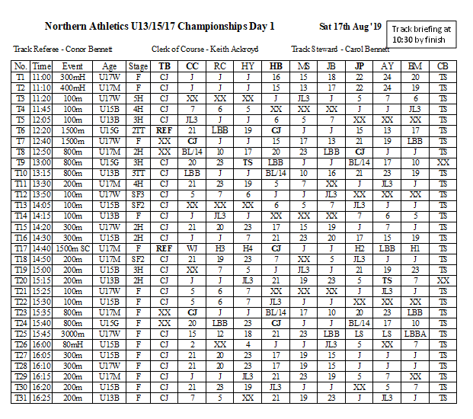
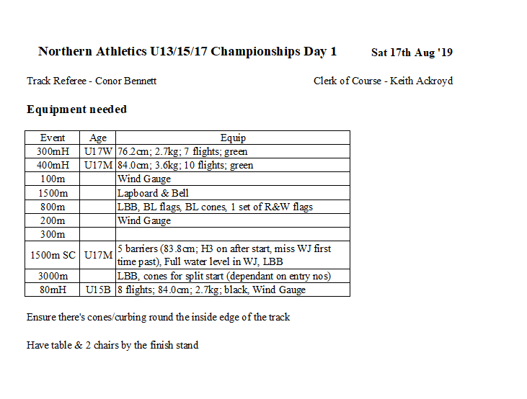
Tasks – Prior to the day
Recruit officials
Liaise with MM re timetable
Create officials’ duty sheet*
Create signing-in sheet
Prepare other documentation for officials (infringement forms/flashcards etc)
Check all equipment that you will need for the programme*
Create script for announcer
NB: Some of this information may be available on a league website or already prepared by the CD/MM

Slide 10
Tasks – On the day (before first event)
Arrive early!
Walk the track – check for any debris or foreign objects
Check all markings – start lines, hurdle/ steeplechase markings, lane lines
Check all equipment – apply to list from previous slide
Liaise with First Aiders – where will they be stationed?
Liaise with Start Team – what relay signals are they following to check each takeover is ready?, how can we communicate during the meeting?
Distribute duty sheet
Brief officials – make sure you are facing the sun, try and do it somewhere
quiet where everyone can hear you

Slide 11
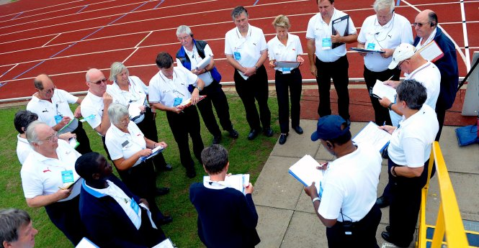
What to include in a track briefing
Introduce yourself & get others to introduce themselves – get to know the team
An emergency action plan – usually discussed in the chiefs briefing (this normally entails ‘follow the directions of the stadium staff)
Ask anyone if they have any questions over the duty sheet and their duties – also any particular things you need to highlight (eg if on lane ends, signal to the stand)
Highlight all H&S matters – do not cross the infield, where umpiring positions are situated for safety reasons etc
How to report an infringement
How equipment is used – some pieces of equipment like the WG vary
Highlight anything judges need to be made aware of that may be happening throughout the day
Where First Aid is positioned if it is needed
Wish everyone a good day

Slide 12
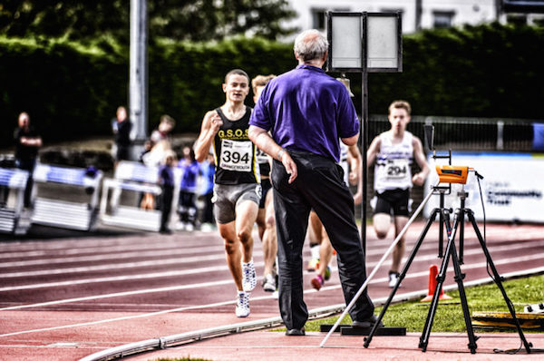
Tasks – During the meeting
Monitor all events
Check that all officials are coping (+ taking breaks)
Deal with any delays
Deal with any problems
Log actual start and finish times for each event
Make notes for any reports on officials

Slide 13
Tasks – After the meeting
Clear everything away
Note any problems / issues for the future
Complete reports and RoE

Slide 14
A handful of examples from recent years
What can possibly
go wrong…?

Slide 15
County Schools T&F Championship (June)
Temp 4º C
Wind NE gusting
Hail showers
Owing to deteriorating weather, you’re concerned about the safety of running
the sprint hurdles
Options:
Go ahead
Postpone
Cancel

Slide 16
County AA Championship (2 day champs)
On Day 1, the Water Jump is not filling up due to a small leak in the landing area. The water isn’t filled to the correct level with 1hr to go before the event is due to start and isn’t expected to be filled at the event start time.
What do you do?
Options:
Go ahead
Modify
Cancel
Postpone

Slide 17
County League meeting
You arrive at the venue to find a JCB parked in lanes 6-8 of the 110m start line and the keys aren’t onsite for it. It is very close to lane 8 coming off the bend.
What action would you take?
Options:
Go ahead. It’s not blocking a lane
Modify and don’t use lane 8 on circular races
Cancel all circular races

Slide 18
ENJOY YOUR ROLE AS A TRACK REFEREE
Any questions, please contact

